Slide 1
Module 11 - Testing & Debugging in Flutter

Slide 2
Learning Objectives
Content:
Identify common issues in Flutter apps
Test logic, UI behavior, and navigation
Validate complete user flows
Use DevTools for debugging UI and performance
Apply these techniques in Lab 11
Notes:
Emphasize practical learning and demo-driven content.

Slide 3
Why Performance Matters
Users expect smooth 60–120 FPS experiences
Poor rebuild patterns increase CPU load
Large assets slow startup times
Inefficient list rendering affects scrolling
App size impacts downloads & Play Store acceptance

Slide 4
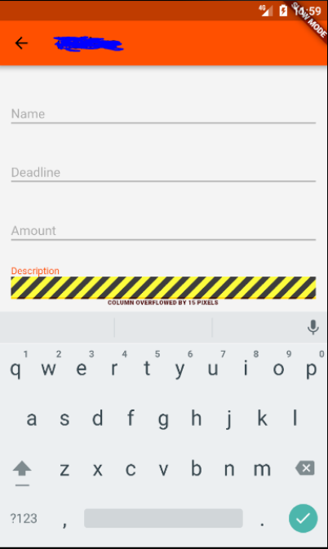
Example of a Flutter UI Problem
UI Overflow Error Example
Occurs when a widget exceeds its layout constraints.
Explain that these issues do not crash the app, so tests or DevTools are needed to detect them.

Slide 5
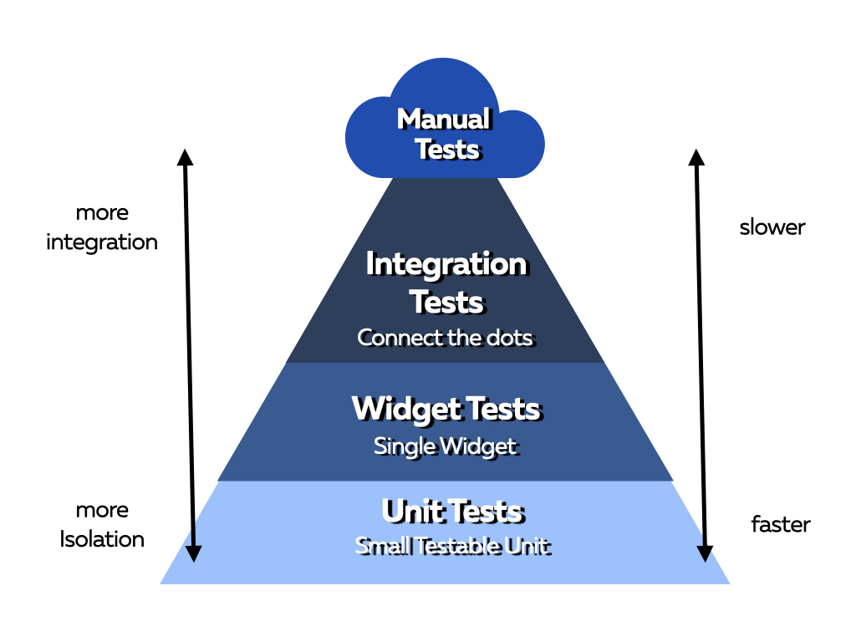
Types of Tests in Flutter
Layered Architecture Diagram
Three essential test types:
Unit Tests
Validate logic without UI
Widget Tests
Validate UI rendering & interaction
Integration Tests
Validate full user flows from start to finish

Slide 6
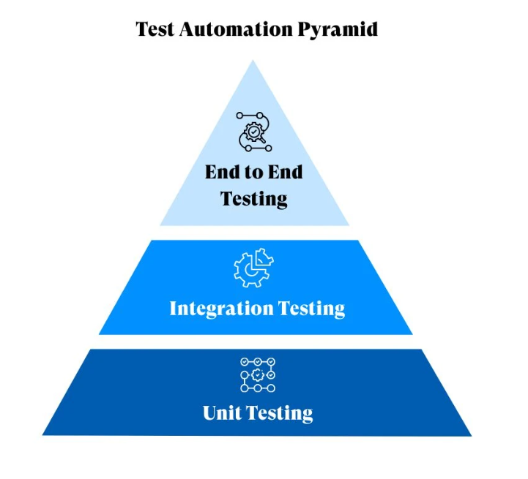
The Flutter Testing Pyramid
Why It Matters
Unit Tests → many
Fast, stable, cheap. Catch logic bugs early.
Widget Tests → moderate
Validate UI behavior and interactions.
Integration Tests → few
Slow & expensive. Use for critical user flows only.

Slide 7
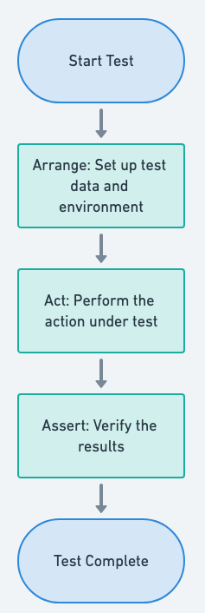
Flutter Testing Workflow
General steps for any Flutter test:
Define the expected behavior
Prepare the test environment
Execute logic / render widget
Simulate interactions
Use expect() to verify the results

Slide 8
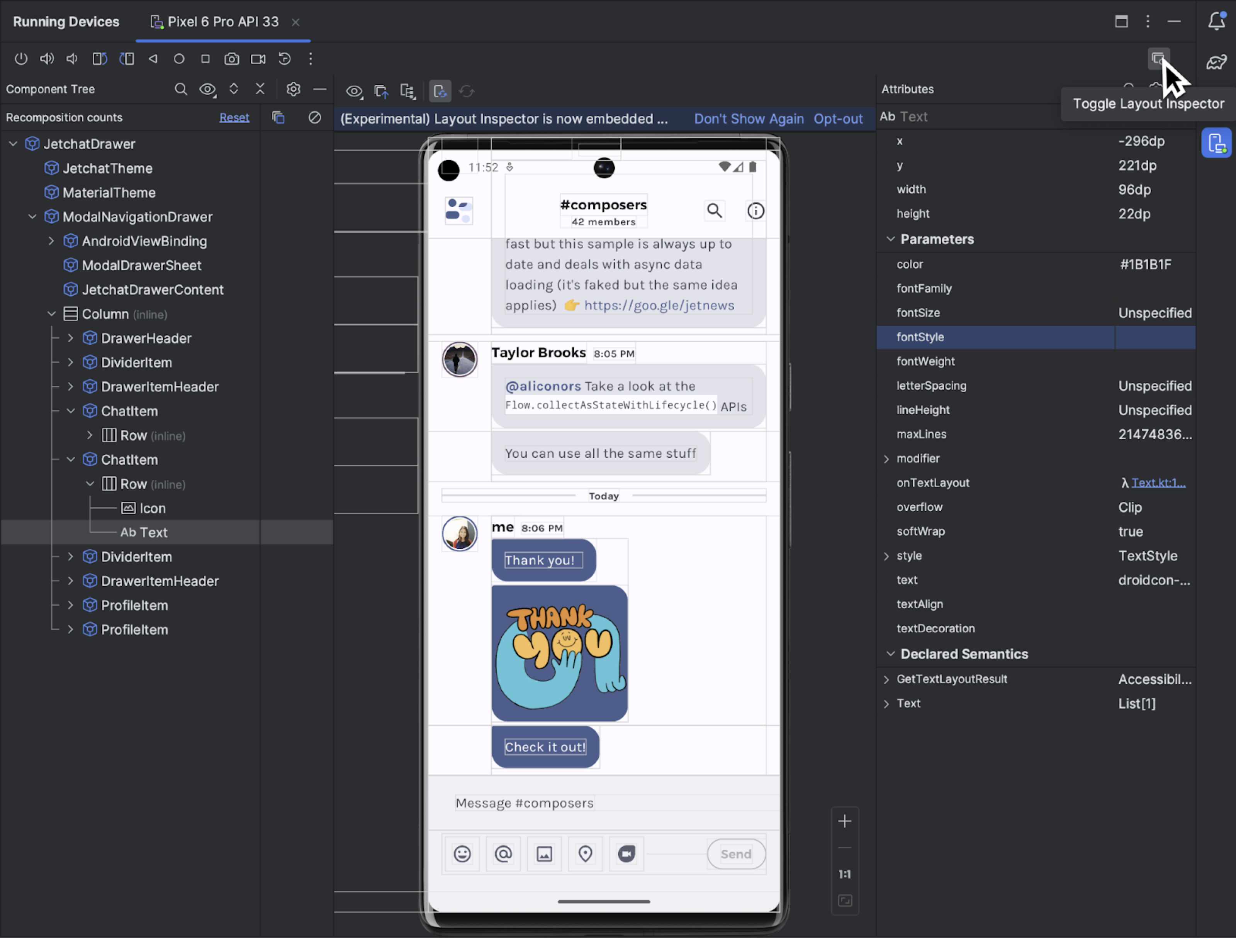
Debugging Goals in Flutter
Debugging in Flutter focuses on:
Layout issues (constraints, overflow)
State update failures
Performance slowdowns
Frequent unnecessary rebuilds
Navigation issues

Slide 9
How Tests Map to Real Flutter Problems
Key Insight
Most UI issues start from logic → unit tests catch problems early.
Layout & interaction problems → widget tests detect what unit tests cannot see.
Multi-screen or user-flow bugs → integration tests validate the entire experience.
Flutter Issue | Recommended Test | Why
Logic failure | Unit test | Fast + stable
UI not updating | Widget test | Validate rebuild
Wrong navigation | Navigation test | Checks route + data
Entire feature broken | Integration test | Simulates real use

Slide 10
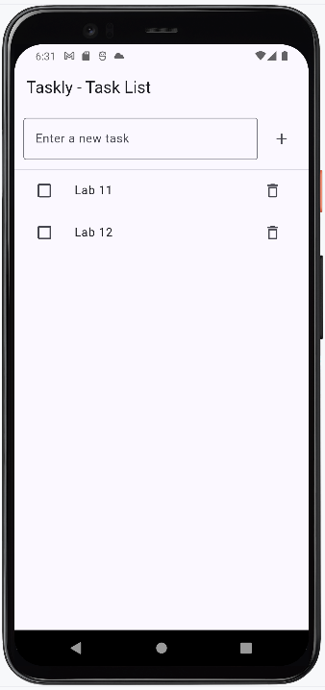
Introducing the Taskly Demo App
We use Taskly, a simple Todo App, to demonstrate each test type:
Features:
Task List screen
Task Detail screen
Add, delete, toggle tasks
Edit and save tasks
Notes:
This one app will support all examples and Lab 11.

Slide 11
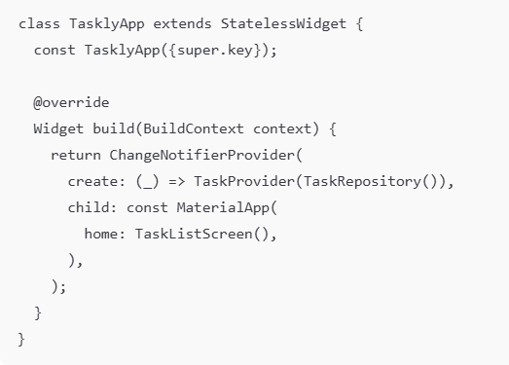
Taskly App Overview
App Structure
TasklyApp is the application's entry point.
Provider (TaskProvider) manages app-wide state.
TaskRepository handles CRUD logic for tasks.
TaskListScreen is the primary UI used in testing.
Why This Matters for Testing
Shows which widget is pumped during tests.
Defines the state flow: UI → Provider → Repository.
Provides context for unit, widget, navigation, and integration testing.

Slide 12
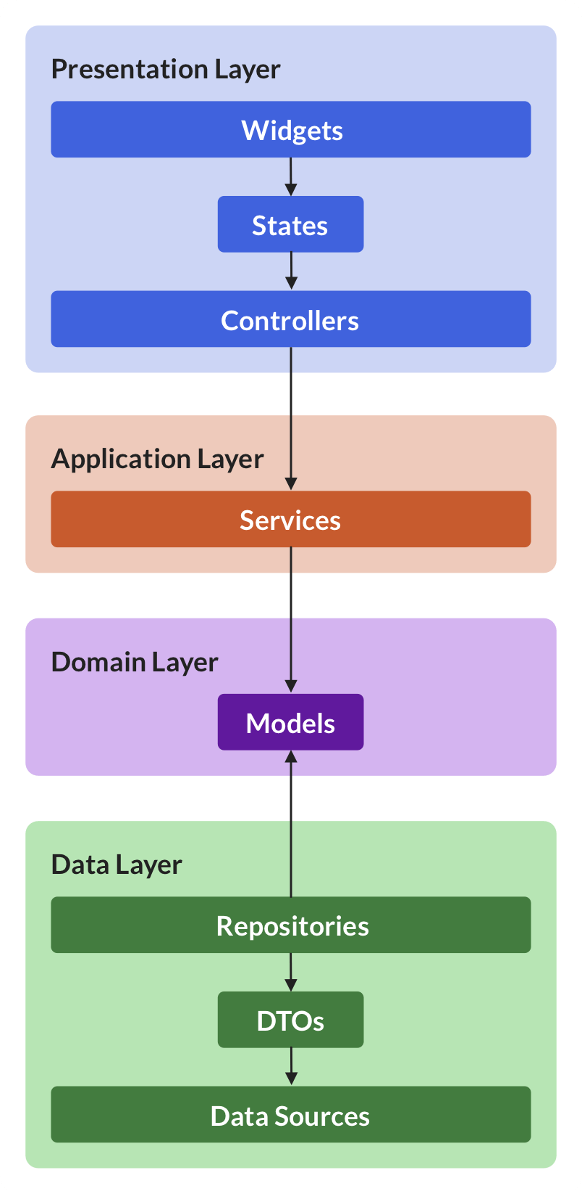
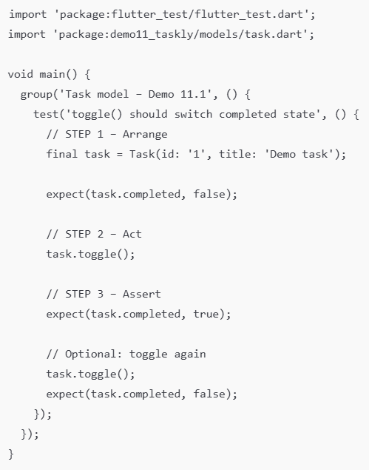
Demo 11.1 – Unit Test: Task Model
File: test/unit/demo_11_1_task_model_test.dart
Notes:
test/unit/demo_11_1_task_model_test.dart
import 'package:flutter_test/flutter_test.dart';
import 'package:demo11_taskly/models/task.dart';
void main() {
group('Task model – Demo 11.1', () {
test('toggle() should switch completed state', () {
// STEP 1 – Arrange
final task = Task(id: '1', title: 'Demo task');
expect(task.completed, false);
// STEP 2 – Act
task.toggle();
// STEP 3 – Assert
expect(task.completed, true);
// Optional: toggle again
task.toggle();
expect(task.completed, false);
});
});
}

Slide 13
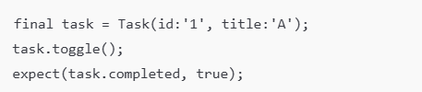
Unit Test Demonstration (Task Model)
What we test here
Toggle completion
Update model state
Logic stays predictable
Expected Output
Initial: completed = false
After toggle(): completed = true
Snippet
Explanation
Line of Code | User Action Simulated | Purpose in the Test | What It Verifies
final task = Task(...) | Creates a new Task object | Arrange: prepare test data | Model starts with known state
task.toggle(); | Toggles completion flag | Act: perform operation | Business logic changes state
expect(task.completed, true); | Check result | Assert: validate output | Logic behaves correctly
Notes:
STEP 1 — Create the correct file path → test/unit/demo_11_1_task_model_test.dart
STEP 2 — Copy the sample test content
STEP 3 — Run the test using the terminal (flutter test)

Slide 14
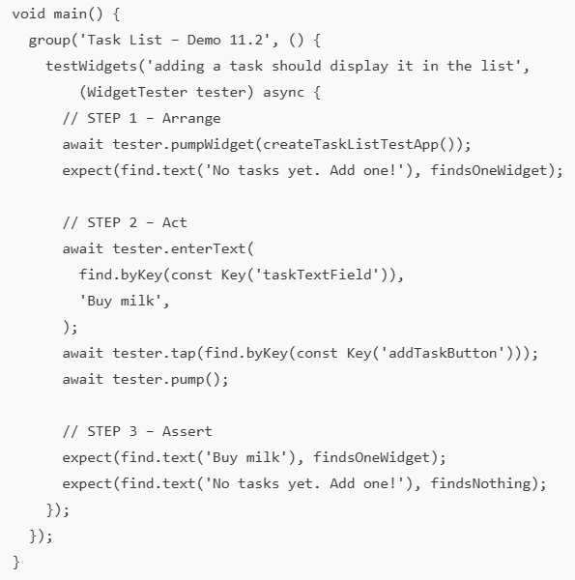
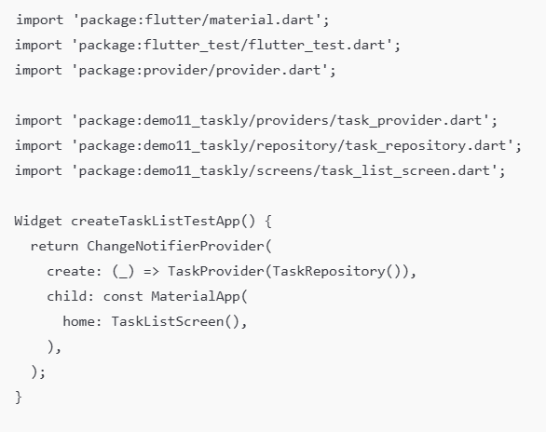
Demo 11.2 – Widget Test: Add Task Updates UI
File: test/widget/demo_11_2_task_list_add_test.dart
Notes:
import 'package:flutter/material.dart';
import 'package:flutter_test/flutter_test.dart';
import 'package:provider/provider.dart';
import 'package:demo11_taskly/providers/task_provider.dart';
import 'package:demo11_taskly/repository/task_repository.dart';
import 'package:demo11_taskly/screens/task_list_screen.dart';
Widget createTaskListTestApp() {
return ChangeNotifierProvider(
create: (_) => TaskProvider(TaskRepository()),
child: const MaterialApp(
home: TaskListScreen(),
),
);
}
void main() {
group('Task List – Demo 11.2', () {
testWidgets('adding a task should display it in the list',
(WidgetTester tester) async {
// STEP 1 – Arrange
await tester.pumpWidget(createTaskListTestApp());
expect(find.text('No tasks yet. Add one!'), findsOneWidget);
// STEP 2 – Act
await tester.enterText(
find.byKey(const Key('taskTextField')),
'Buy milk',
);
await tester.tap(find.byKey(const Key('addTaskButton')));
await tester.pump();
// STEP 3 – Assert
expect(find.text('Buy milk'), findsOneWidget);
expect(find.text('No tasks yet. Add one!'), findsNothing);
});
});
}

Slide 15
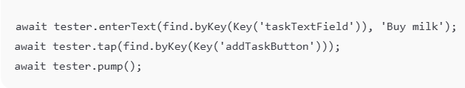
Widget Test Demonstration (Add Task Interaction)
What we test
Enter text
Tap “Add”
List updates with newly added task
Expected Output
Before: “No tasks yet. Add one!”
After: “Buy milk”
What this proves
UI rebuilds correctly
Provider state updates
ListView reacts to new data
Snippet
Explanation
Line of Code | User Action Simulated | Purpose in Test | What It Verifies
enterText(..., 'Buy milk') | User types into the input field | Act: simulate typing | The TextField accepts input
tap(addTaskButton) | User presses the Add button | Act: trigger UI action | Provider receives update request
pump() | UI rebuild | Assert preparation | The new task appears on screen

Slide 16
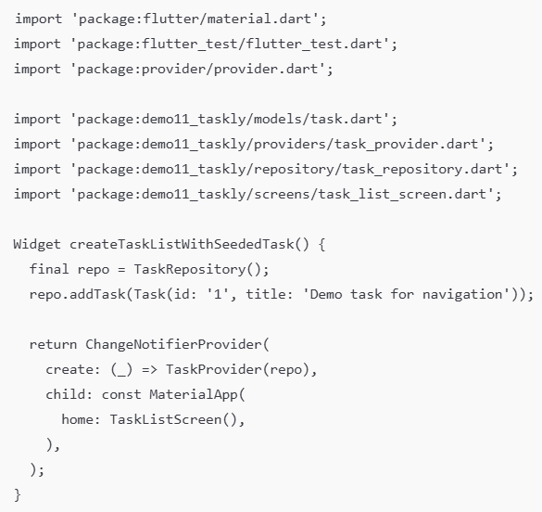
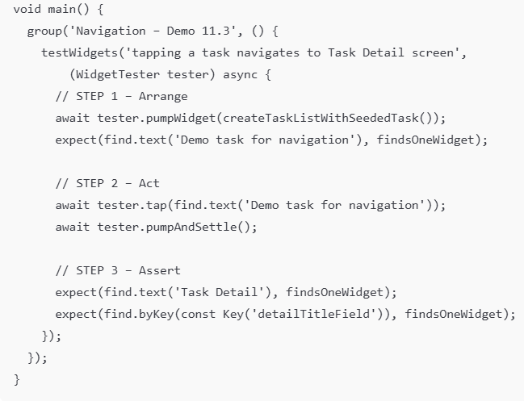
Demo 11.3 – Navigation Test: List → Detail
File : test/widget/demo_11_3_navigation_to_detail_test.dart

Slide 17
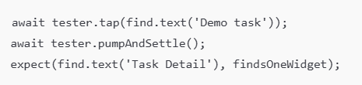
Navigation Test Demonstration (List → Detail)
What We Test
Click on the item in the list
Navigate to the detail screen
Data passed to the detail is correct
Expected output
New screen shows: "Task Details"
Detail form loaded with task data
Why this is important
Navigation errors are common
Ensure routes and widget tree are correct
Snippet
Explanation
Line of Code | User Action Simulated | Purpose in Test | What It Verifies
tap(find.text('Demo task')) | User taps a list item | Act: trigger navigation | Navigation event is fired
pumpAndSettle() | Wait for animations & navigation | Arrange for assertion | Destination screen fully loads
expect(find.text('Task Detail')...) | Check screen title | Assert: confirm navigation result | App navigated to the correct page

Slide 18
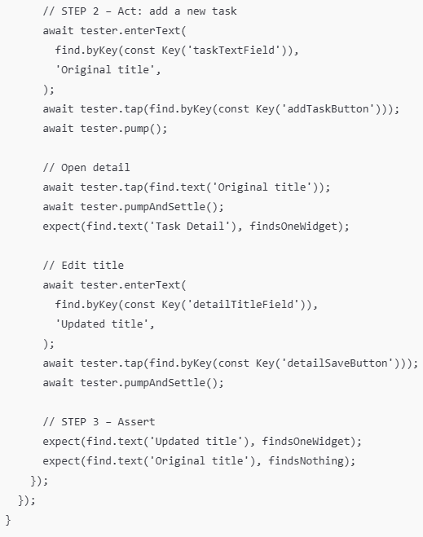
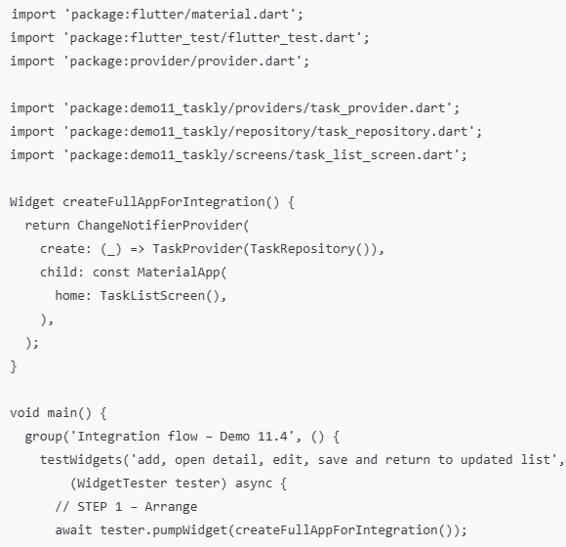
Demo 11.4 – Integration Test: Full CRUD Flow
File: test/widget/demo_11_4_integration_flow_test.dart
Notes:
import 'package:flutter/material.dart';
import 'package:flutter_test/flutter_test.dart';
import 'package:provider/provider.dart';
import 'package:demo11_taskly/providers/task_provider.dart';
import 'package:demo11_taskly/repository/task_repository.dart';
import 'package:demo11_taskly/screens/task_list_screen.dart';
Widget createFullAppForIntegration() {
return ChangeNotifierProvider(
create: (_) => TaskProvider(TaskRepository()),
child: const MaterialApp(
home: TaskListScreen(),
),
);
}
void main() {
group('Integration flow – Demo 11.4', () {
testWidgets('add, open detail, edit, save and return to updated list',
(WidgetTester tester) async {
// STEP 1 – Arrange
await tester.pumpWidget(createFullAppForIntegration());
// STEP 2 – Act: add a new task
await tester.enterText(
find.byKey(const Key('taskTextField')),
'Original title',
);
await tester.tap(find.byKey(const Key('addTaskButton')));
await tester.pump();
// Open detail
await tester.tap(find.text('Original title'));
await tester.pumpAndSettle();
expect(find.text('Task Detail'), findsOneWidget);
// Edit title
await tester.enterText(
find.byKey(const Key('detailTitleField')),
'Updated title',
);
await tester.tap(find.byKey(const Key('detailSaveButton')));
await tester.pumpAndSettle();
// STEP 3 – Assert
expect(find.text('Updated title'), findsOneWidget);
expect(find.text('Original title'), findsNothing);
});
});
}

Slide 19
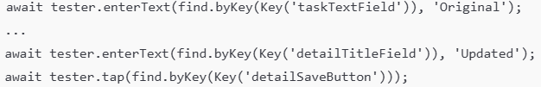
Integration Test Demonstration (Full Task Flow)
What we test
Add task
Open detail
Edit title
Save
Confirm new title appears in list
Expected Output
Old title disappears
New title displayed
Snippet
Explanation
Line of Code | User Action Simulated | Purpose in Test | What It Verifies
enterText(taskTextField, 'Original') | User creates a new task | Step 1 – Add task | Input field and add flow work
enterText(detailTitleField, 'Updated') | User edits the task title | Step 2 – Edit task | Detail screen correctly receives data
tap(detailSaveButton) | User saves the edited task | Step 3 – Save operation | Provider updates data + UI refresh
Notes:
Why integration tests are important
Validate entire user journey
Ensure that all layers (UI → Provider → Repository) interact correctly

Slide 20
Best Practices
Keep tests small and focused
Use keys for widget tests
Mock repositories when possible
Avoid testing Flutter framework functionality
Don’t overuse integration tests

Slide 21
Summary
In this module, students learned:
In this module, students learned how to:
Identify common UI and state-related issues in Flutter apps
Apply the Flutter testing pyramid (Unit → Widget → Integration)
Write unit tests to verify logic and model behavior
Write widget tests to validate UI rendering and interactions
Write integration tests to confirm full user flows
Use DevTools to diagnose layout, rebuild, and navigation issues

Slide 22
References
Mastering Flutter 2025: Learn to Develop Flutter Apps, Kevin Moore, Packt Publishing. Chapter 13, 14, 15
Flutter Documentation – Testing: https://docs.flutter.dev/cookbook/testing
Flutter Documentation – DevTools: https://docs.flutter.dev/tools/devtools/overview
Provider Package Documentation: https://pub.dev/packages/provider
flutter_test Library API Reference: https://api.flutter.dev/flutter/flutter_test/flutter_test-library.html

